Slide 1
Technical Architecture
TECH STACK
APPLICATION LAYER
Angular + Python + Langchain
User Layer
Front End Application
AI Agents
Python + Django + FastAPI
Integration Layer
Backend Application
n8n Workflow Engine
Arcade + Qdrant + PostGreSQL
Database
API Gateway
Graph + Vector + SQL
Lanfuse + All LLM models
AI Module
LLM Observability
LLM Models

Slide 2
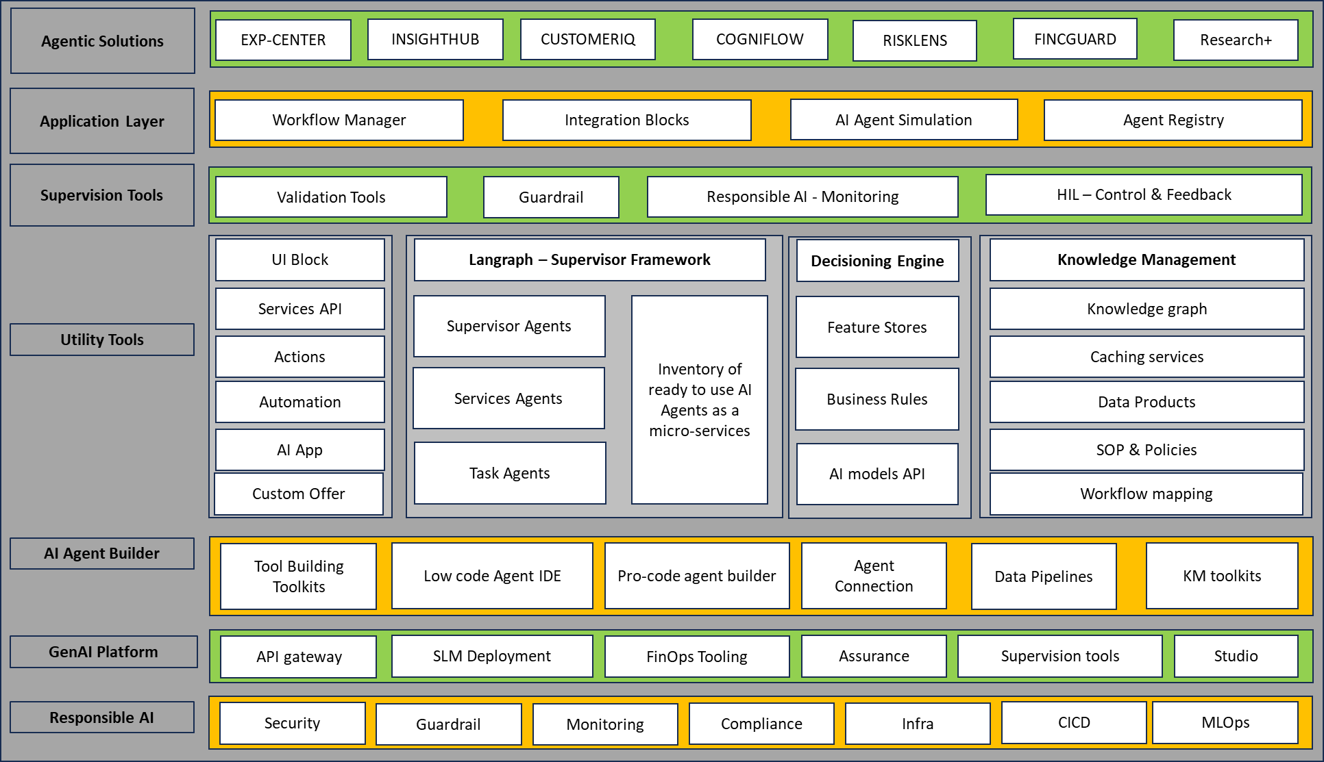
Reference Architecture
Agentic Solution 1
Agentic Solution 2
Agentic Solution X

